Slide 1
“I Am Sorry But We Have to Let You Go”
What to Do When You Are Laid Off

Slide 2
Layoffs Generally
Management generally does not have to bargain with APC about the decision to layoff Unit 4 employees; however, it must bargain with APC about the impact of that decision on Unit 4 employees.
“[A] public employer' s decision to implement layoffs is not within the scope of representation, rather, only the effects of a layoff are within scope.”
Marin County Super. Ct., PERB Dec. No. 2216-C (2011)

Slide 3
Layoffs Generally

Slide 4
Layoffs Generally cont.
The decision to lay off Unit 4 employees generally cannot be challenged in a grievance; however, a violation of the layoff procedures can be challenged in a grievance.
“When the President determines that a layoff is necessary on a campus because of a lack of work or lack of funds, the following procedures shall apply.” (Article 33.1)

Slide 5
Layoffs Generally cont.
Management cannot layoff Unit 4 employees and, at the same time, rely more heavily on student assistants and administrators to perform Unit 4 work.
“When the CSU determines that there is a need for implementation of any procedures in Article 33, Layoff, the number of student assistant hours and the number of administrators shall not be increased for the purpose of performing bargaining unit work.” (Article 33.6)

Slide 6
Layoffs Generally cont.
They can look, but they can’t touch.

Slide 7
What Is NOT a “Layoff”?
Non-Renewal of Temporary Appointments
a. Article 13.6
“Temporary appointments shall specify in writing the expiration date of the appointment . . . . Temporary appointments automatically expire at the end of the period stated and do not establish consideration for subsequent appointments or any further appointment rights except as provided for in this Article.”
b. Article 33.7
“Non-reappointment of a[] temporary employee does not constitute a layoff.”

Slide 8
What Is NOT a “Layoff” cont.
“Early Separation” from Temporary Appointments
“Temporary appointments shall specify in writing . . . that the appointment may expire prior to that date. Such an early separation shall normally require a ten (10) day notification.”
(Article 13.6)

Slide 9
What Is NOT a “Layoff” cont.
“Rejection” During Probation
“A probationary employee may be separated from service at any time by the President upon written notice of rejection during probation. The employee should normally be given not less than three (3) weeks notice of rejection during probation.”
(Article 14.16.A)

Slide 10
Notice of Layoff
33.22
Except as provided in Article 13, Appointment, a temporary or probationary employee who is to be laid off shall receive notice of such layoff from the President no later than thirty (30) days before the effective date of layoff.
33.23
A permanent employee who is to be laid off shall receive notice of such layoff from the President no later than forty-five (45) days prior to the effective date of layoff.

Slide 11
Notice of Layoff cont.
33.24
All notices of layoff shall be in writing and mailed by certified mail, return receipt requested, to the employee's last known mailing address.

Slide 12
Order of Layoff Generally
“Layoff shall be within classifications determined by the President. Ten (10/12) month, eleven (11/12) month, twelve (12) month and academic year positions with the same class title shall, for the purposes of layoff, be considered a single class. The order of layoff shall be:
A. first, intermittent employees
B. second, temporary employees;
C. third, probationary employees;
D. last, permanent employees.
Intermittent employees who perform work on an irregular basis may be excluded from layoff at the discretion of the President.” (Article 33.7)

Slide 13
Order of Layoff: Temporary & Probationary Employees
The order of layoff for temporary and probationary employees in the same classification requires consideration of “specialized skills and competency” and “documentable meritorious service” of each employee.
“The President shall establish the order of layoff for temporary and probationary employees in a classification by considering only the following factors: [¶] A. specialized skills and competency of the employee in relation to program need; and [¶] B. documentable meritorious service of the employee.” (Article 33.8)

Slide 14
Permanency for Temporary Employees
After four consecutive years as a temporary employee with a timebase of 50% or more, you must be granted permanency and will then enjoy the greater layoff protections of a permanent employee.
See Articles 13.7 and 13.8 for details.

Slide 15
Permanency for Probationary Employees
After one year as a probationary employee, you should be granted permanency and will then enjoy the greater layoff protections of a permanent employee.
See article 14.3 and 14.17 for details.

Slide 16
Order of Layoff: Permanent Employees
1. Article 33.9
“The order of layoff for permanent employees in a classification shall be in reverse order of seniority.”
2. Article 33.10
“A permanent employee who possesses documentable specialized skills that are needed for the program, not possessed by other employees in classification(s) undergoing layoff, may be excluded by the President from the layoff list.”
3. Articles 33.20 & 33.21
“A tie exists when two (2) or more permanent employees in a classification undergoing layoff have the same number of seniority points. [¶] The President shall break ties in establishing the layoff order of permanent employees by considering documentable specialized skills and the competencies of the employee.”

Slide 17
Calculation of Seniority
“Seniority” does not mean “hierarchy” as in the picture on the right. Rather, it means “length of service,” as explained on the following slides.

Slide 18
Calculation of Seniority
“Full-time permanent ten (10/12) month employees, eleven (11/12) month employees, twelve (12) month employees, and academic year employees shall earn one (1) seniority point of service credit in a given class for each qualifying month of employment. Part-time employees holding permanent status shall earn seniority points proportional to the time base served. In no case shall a permanent employee earn more than twelve (12) seniority points per year.” (Article 33.12)

Slide 19
Calculation of Seniority cont.
“For the purpose of computing permanent employee seniority credit, length of service includes continuous time served on the campus as a temporary, probationary or permanent employee and is counted from the date of appointment to the current class held, consistent with provision 33.13 below plus any service in classes of equal or higher rank on the campus which has not been interrupted by a permanent separation. The term "class of equal rank" as used in this Article shall mean a class of not more than one-half (1/2) step (approximately two and one-half (2-1/2) percent) . . . below the maximum salary of the employee's current class.”
(Article 33.13)

Slide 20
Calculation of Seniority cont.
During certain types of leaves from Unit 4 employment, permanent employees keep earning Unit 4 seniority credit.
“All time spent in family care, military, disability, loan of an employee to another governmental agency or leave with pay status shall count toward the accumulation of seniority points.”
(Article 33.18)

Slide 21
Calculation of Seniority cont.
During other types of leave from Unit 4 employment, permanent employees do not keep earning Unit 4 seniority credit; however, such leaves also do not constitute a break in service that would extinguish Unit 4 seniority.
1. Article 33.18
“All other time spent in leave without pay status, as well as periods of suspension without pay, shall not count toward the accumulation of seniority points; however, such time shall not constitute a break in continuous service.”

Slide 22
Calculation of Seniority cont.
2. Article 33.15
“Service in another bargaining unit does not count for seniority purposes in Unit 4, but it [also] does not count as a break in continuous service for the purposes of retaining previously earned Unit 4 seniority.”
3. Article 33.14
“[A] Unit 4 employee may be temporarily reassigned to serve in either an MPP or non-represented classification for up to twenty-four (24) months without the employee having a break in in continuous service or losing prior earned seniority points.”

Slide 23
Seniority Exercise
The Department currently employs three SSP IIAs:
1. Anna, who three years ago was hired as an SSP IA and one year ago was promoted to SSP IIA ;
Betty, who five years ago was hired as an SSP IIIA at the maximum of that salary range. Two years ago, she was suspended without pay for one year. Thereafter, she accepted a demotion to SSP IIA to get out from under her immediate supervisor, whom she blamed for her suspension.
Connie, who three years ago was hired as an SSP IIA;
Debby, who two years ago was hired as an SSP IIA;
Who is laid off first? Second? Third? Last? Assume all are 12-months.

Slide 24
Seniority Exercise cont.
Anna is laid off first. She has at most one year of seniority. Her two years as SSP IA do not count, because that is a class of lower rank, rather than of equal or higher rank.
Debby is laid off second. She has two years of seniority.
Connie is laid of third. She has three years of seniority.
Betty is laid off last. She has four years of seniority. Her three years as SSP IIIA count because that is a class of higher rank. Her one-year suspension without pay does not count towards her seniority; however, it also does not constitute a break in service that would extinguish her prior seniority. Her one year as SSP IIA is added to the three.

Slide 25
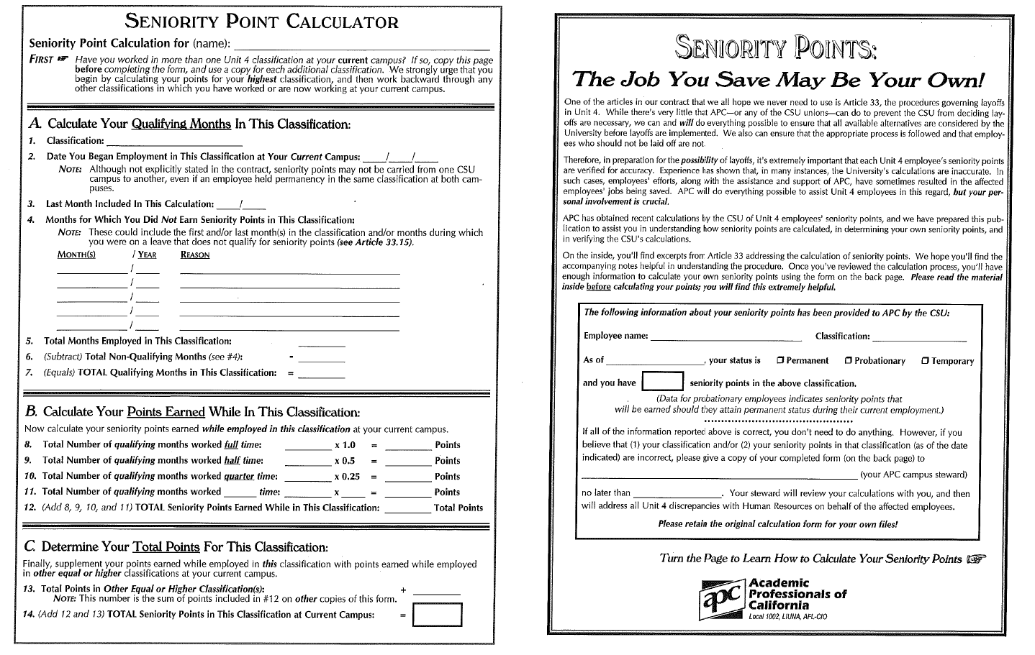
Calculation of Seniority cont.

Slide 26
Calculation of Seniority cont.
Permanent separation from union-represented CSU employment or “temporary reappointments” to an MPP or non-represented CSU classification for more than twenty-four months constitutes a break in service that extinguishes Unit 4 seniority, even if the employee later applies for and is hired into a Unit 4 position as an outside applicant.
“After twenty-four (24) months [of “temporary reassignment: to an MMP or non-represented classification] there will be a break in continuous service for the purposes of retaining Unit 4 seniority.” (Article 33.14)

Slide 27
Added Job Protection for Probationary & Permanent Employees
Probationary and permanent employees can be laid off only if no student assistants performing the same or comparable work remain.
“Student assistants performing work that is the same as, or comparable to, the work performed by a probationary or permanent employee in a classification within an organizational unit undergoing layoff shall be separated prior to laying off any probationary or permanent employee in the classification within the organizational unit undergoing layoff.” (Article 33.5)

Slide 28
The Problem with Student Employees

Slide 29
“Bumping” Rights for Probationary & Permanent Employees
1. Article 33.26
“A permanent or probationary employee who has received a notice of layoff may elect to be transferred or demoted to any classification in which he/she has served as a permanent employee during the period preceding the layoff, provided . . . there has been no break in service[] and the employee is currently qualified for the position.”
2. Article 33.27
“In order to elect the options in provisions . . . 33.26 above, an employee must notify the campus Human Resources Office in writing not later than seven (7) days after receiving the notice of layoff.”

Slide 30
“Bumping” Rights cont.
3. Article 33.28
“An employee replaced by the demotion or transfer of an employee who has received a notice of layoff shall have the same [transfer and bumping] rights as outlined in provisions . . . 33.26 above of this Article.”

Slide 31
“Bumping” Rights Exercise
Assume the facts described in the “Seniority Exercise” we discussed earlier. Assume further that the Department currently also employs an SSP IA, Edie, who was hired into that position a year ago. If Anna, Connie, Debby, and Betty have all been laid off, does this additional assumption change something for any of them?

Slide 32
“Bumping” Rights Exercise cont.
Yes:
Anna has at least two years (and possibly three years) of seniority as SSP IA.
Edie has at most one year of seniority as SSP IA.
Therefore, Anna can “bump” Edie out of her SSP IA position, if Anna is still qualified for that position.

Slide 33
“Transfer” Rights for Permanent Employees
1. Article 33.25
“A permanent employee who has received a notice of layoff may exercise his/her right to elect transfer to any vacancy on the campus in the bargaining unit for which he/she is currently qualified. Such qualifications shall be determined in the normal manner. When two (2) or more such permanent employees elect transfer to the same vacancy in accordance with this provision, the employee to be transferred shall be selected on the basis of any of the following factors: [¶] A. specialized skills and competencies of the employee; and [¶] B. documented meritorious service of the employee.”

Slide 34
“Transfer” Rights cont.
2. Article 33.27
“In order to elect the options in provisions 33.25 . . . above, an employee must notify the campus Human Resources Office in writing not later than seven (7) days after receiving the notice of layoff.”

Slide 35
“Reemployment” Rights for Permanent Employees
1. Article 38.30
“The name of a laid off permanent employee shall be entered on a reemployment list by class in order of seniority. A name may remain on a reemployment list for five (5) years. It is the obligation of the laid off person to notify the campus of address change.”

Slide 36
“Reemployment” Rights cont.
2. Article 38.31
“Position vacancies in a class for which there are names of qualified individuals on the reemployment list shall not be filled without first making an offer of reemployment to those on the list. If any individual on the reemployment list declines two (2) such offers, he/she waives his/her reemployment rights. An individual on a reemployment list may request inactive status for up to one (1) year.”

Slide 37
Closing Thought

