Slide 1
In-Range Progression & Reclassification
How the CBA Can Help You to Get a Pay Raise, and How PERB Charges & Grievances Can Help When the CBA Doesn’t

Slide 2
Grinch-Time

Slide 3
Race to the Bottom: All Classifications
Total Unit 4 Members: 2348
Within 5% of Salary Range Floor: 1281 (55%)
At Salary Range Floor: 868 (37%)

Slide 4
Race to the Bottom: The Big Four
Total SSP I B: 196
Within 5% of Salary Range Floor: 140 (72%)
At Salary Range Floor Itself: 101 (52%)
Total SSP II A: 855
Within 5% of Salary Range Floor: 593 (69%)
At Salary Range Floor: 441 (52%)

Slide 5
Race to the Bottom: The Big Four
Total SSP III A: 614
Within 5% of Salary Range Floor: 258 (42%)
At Salary Range Floor: 152 (25%)
Total IV A: 241
Within 5% of Salary Range Floor: 64 (27%)
At Salary Range Floor: 35 (15%)

Slide 6
The View from the Boardroom I

Slide 7
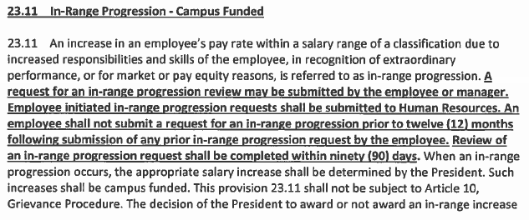
New & improved Language

Slide 8
Summary of Changes
Whereas before, Unit 4 employees on some campuses did not have the right to submit In-Range Progression requests directly to HR, now Unit 4 employees on all campuses have that right.
Where as before, Unit 4 employees on some campuses had to wait twelve months from the receipt of a response to a prior In-Range Progression request before submitting a new request, now Unit 4 employees on all campuses have to wait twelve months from the submission of a prior request before submitting a new one.
Whereas before, there was no time limit on the review of an In-Range Progression request, now the review must be completed within ninety days.

Slide 9
Effective Date of the Changes
The changes described in this presentation became effective only upon ratification of the Memorandum of Understanding by the Board of Trustees on November 12, 2014.
We are experiencing some delay in the development of new campus forms and procedures. Be patient, but report problems!

Slide 10
The View from the Boardroom II

Slide 11
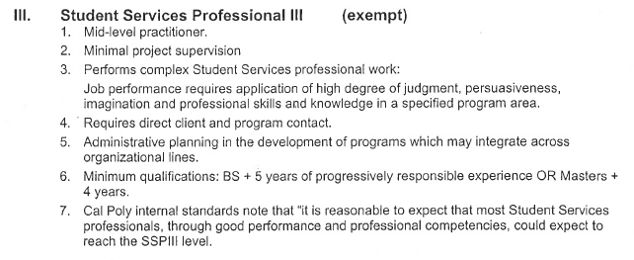
Moving On: SLO Before

Slide 12
Staying Put: SLO After

Slide 13
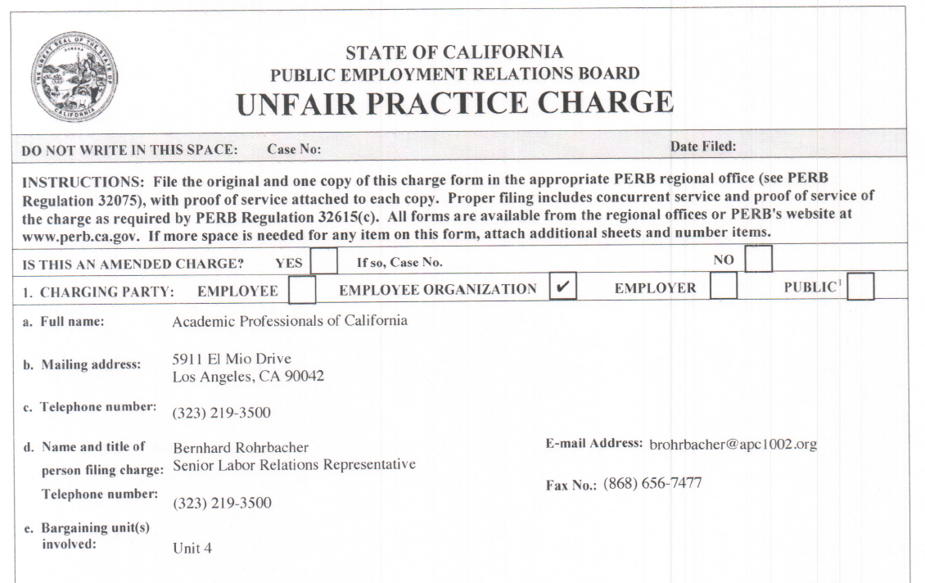

Slide 14
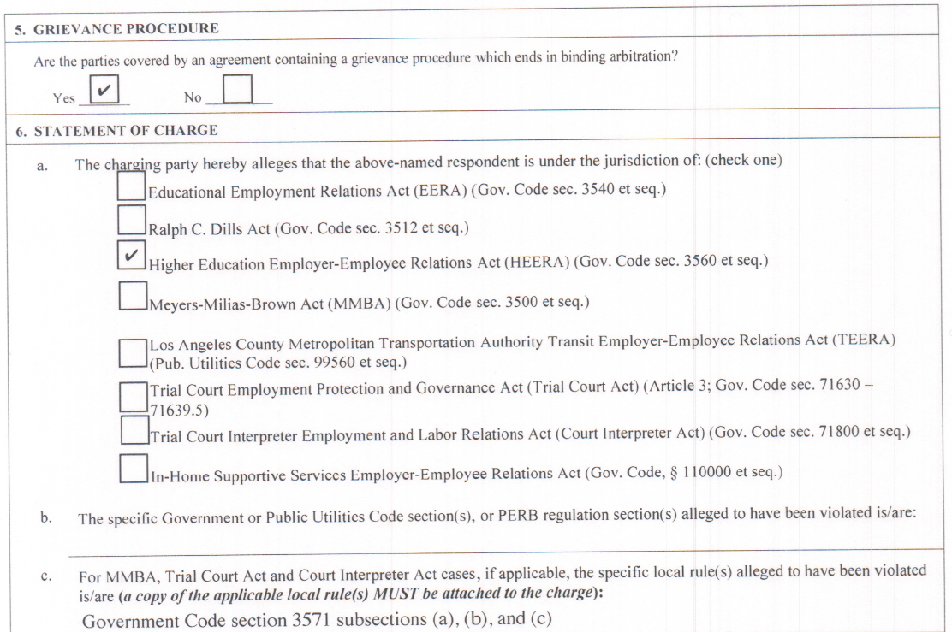

Slide 15
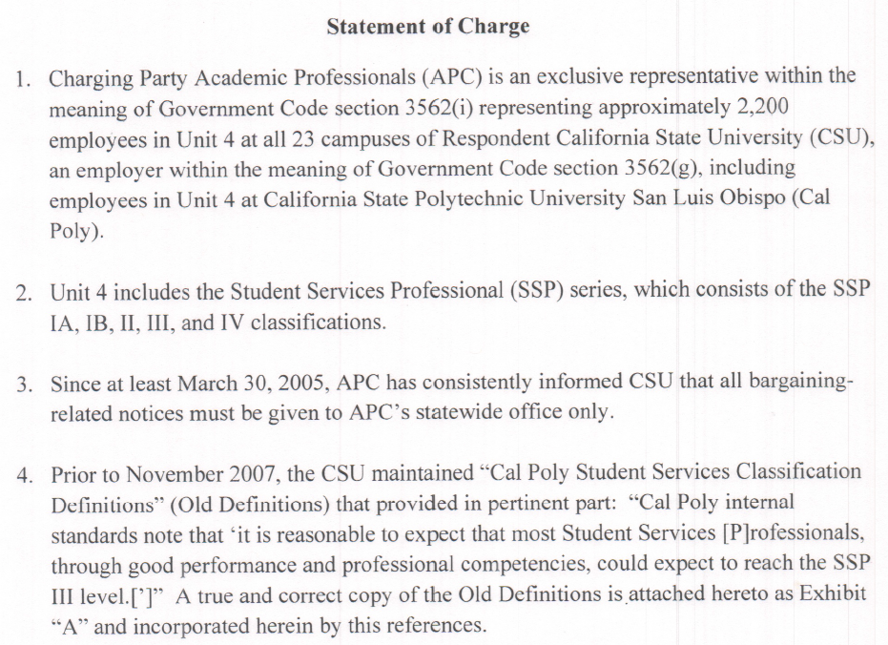

Slide 16
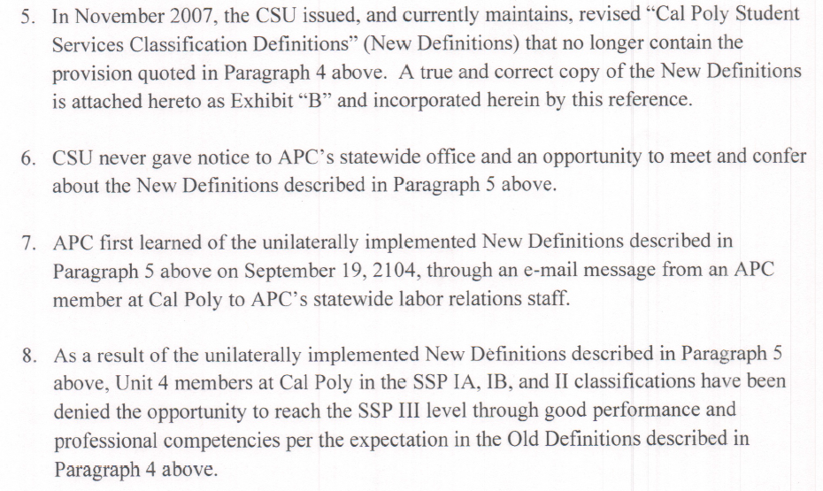

Slide 18
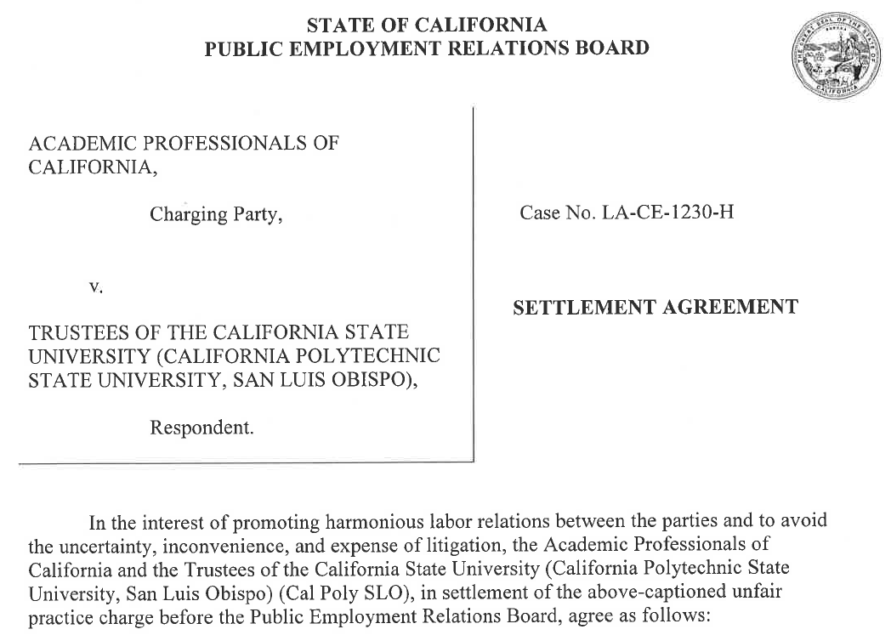

Slide 19
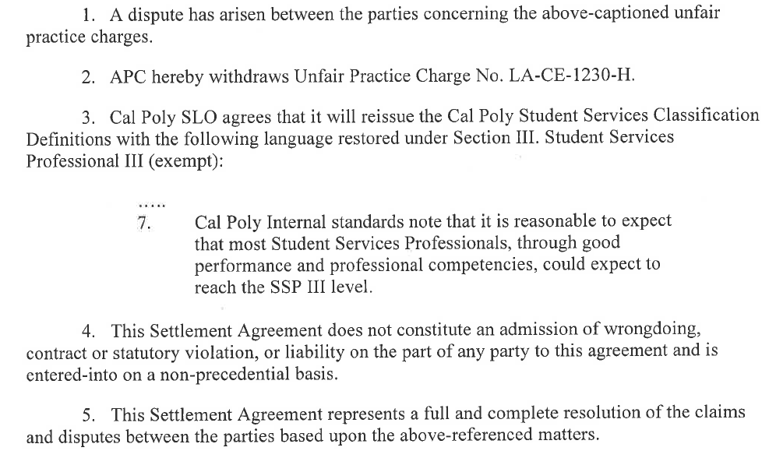

Slide 20
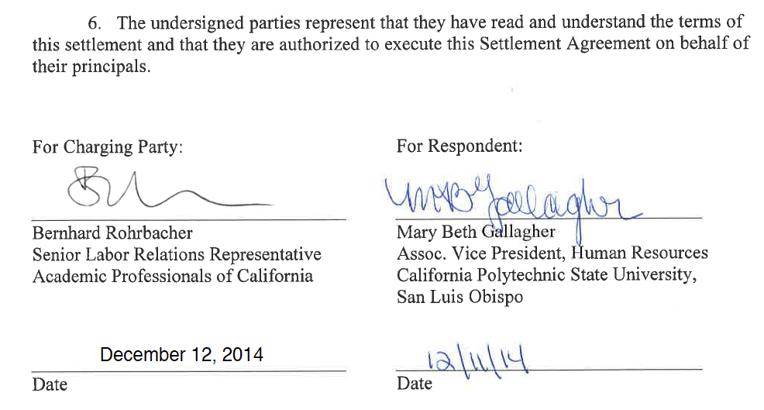

Slide 21
The View from the Boardroom III

Slide 22
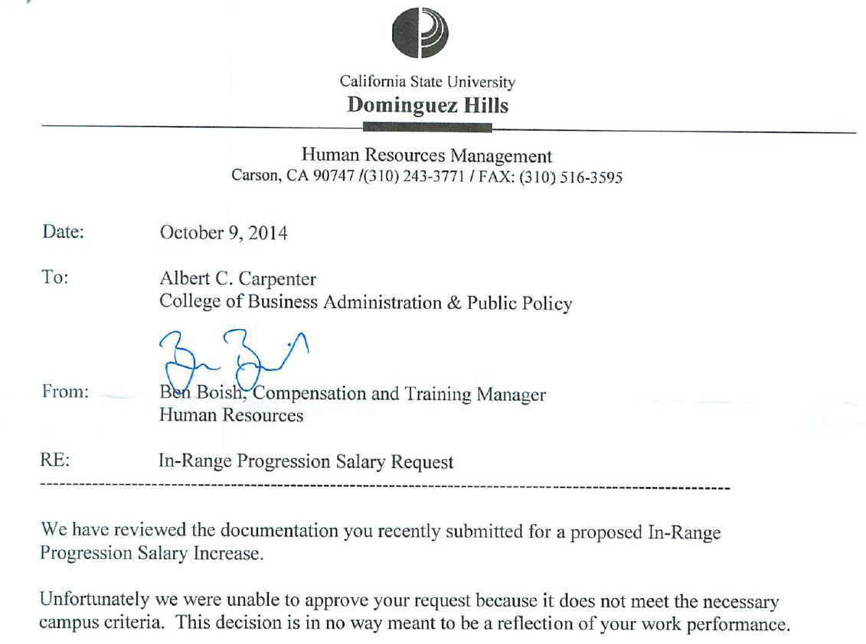

Slide 23
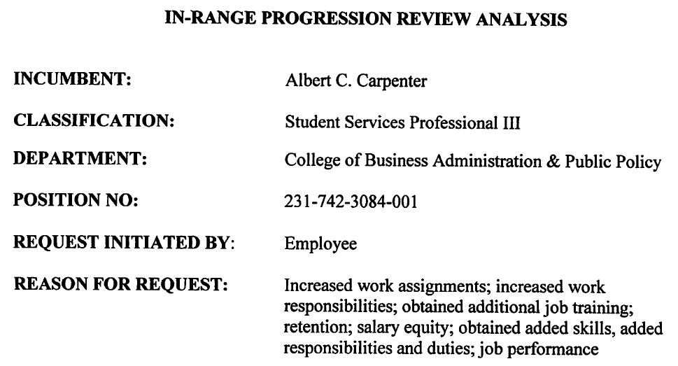

Slide 25
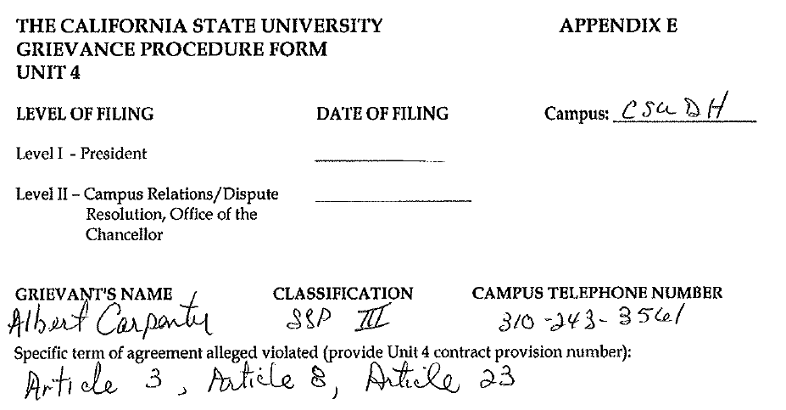

Slide 26
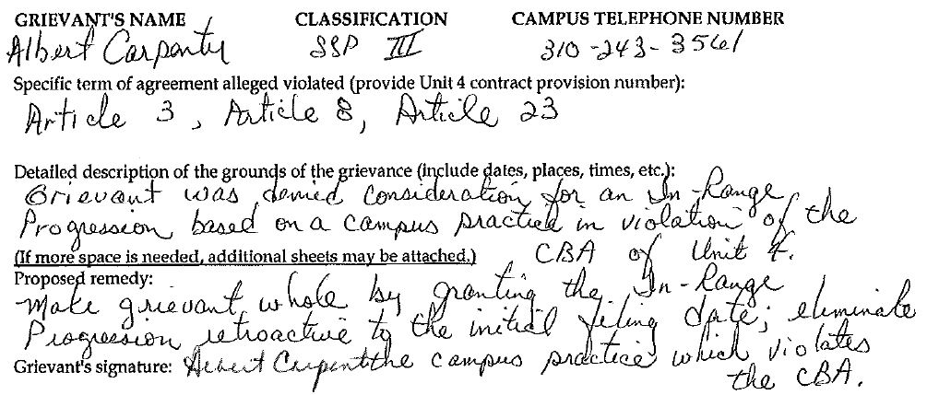

Slide 27
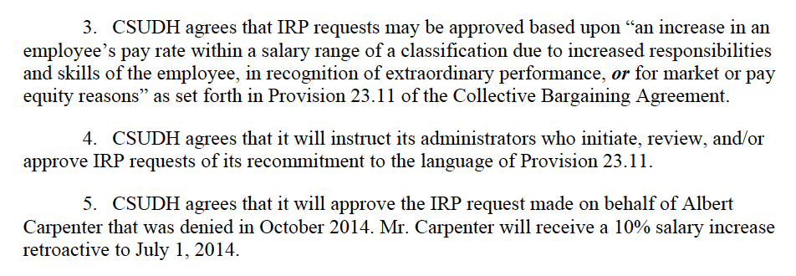
Settlement Agreement

Slide 28
The View from the Board Room IV

Slide 29
Reclassification: APC CBA
13.12 Employees who believe they are misclassified may request a classification review in accordance with campus procedure. APC may also request a classification review in accordance with the campus procedure if the Union believes employee(s) are misclassified. The decision or outcome of the classification review cannot be appealed to the grievance or arbitration procedures contained in the agreement.

Slide 30
Temporary Reassignment: APC CBA
17.4 An employee may be temporarily assigned to a position(s) in a higher or lateral classification within Unit 4, the Management Personnel Plan (“MPP”), or another bargaining unit by the President for no more than twenty-four months, when the President determines such an assignment is in the best interests of the campus. An employee shall be provided with notice of such a temporary assignment at least fourteen (14) days prior to the effective date of such a temporary assignment.

Slide 31
The View from the Board Room V

Slide 32
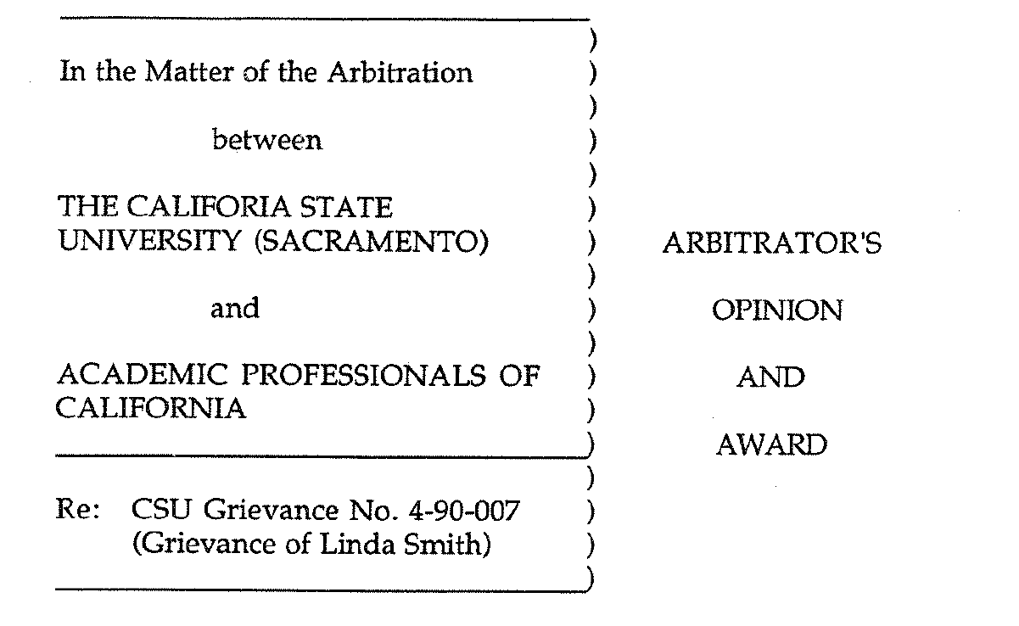
Case Study I: Sacramento (Smith)

Slide 33
Case Study I: Sacramento (Smith)
. . .

Slide 34
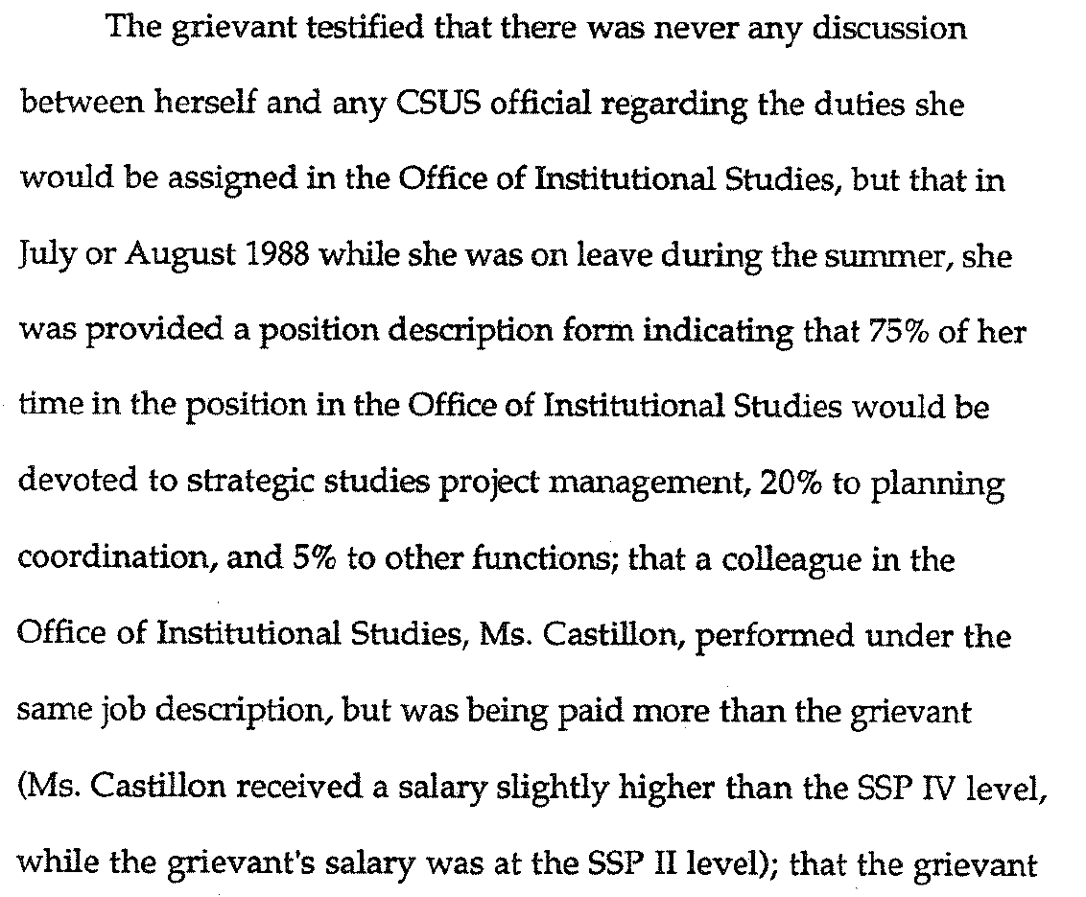
Case Study I: Sacramento (Smith)

Slide 35
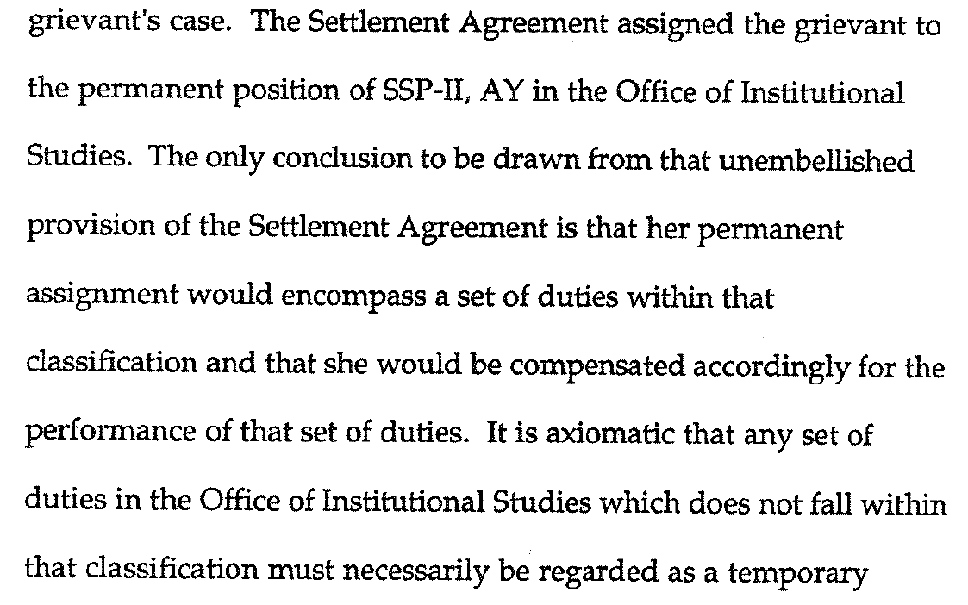
Case Study I: Sacramento (Smith)

Slide 36
Case Study I: Sacramento (Smith)

Slide 37
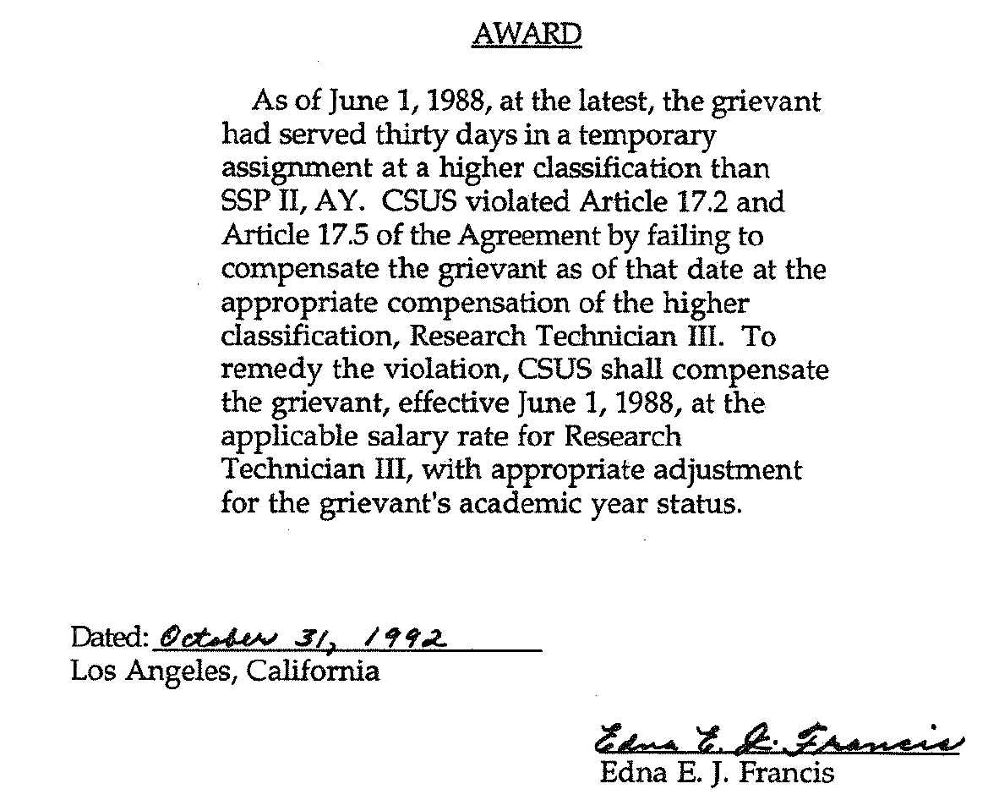
Case Study I: Sacramento (Smith)

Slide 38
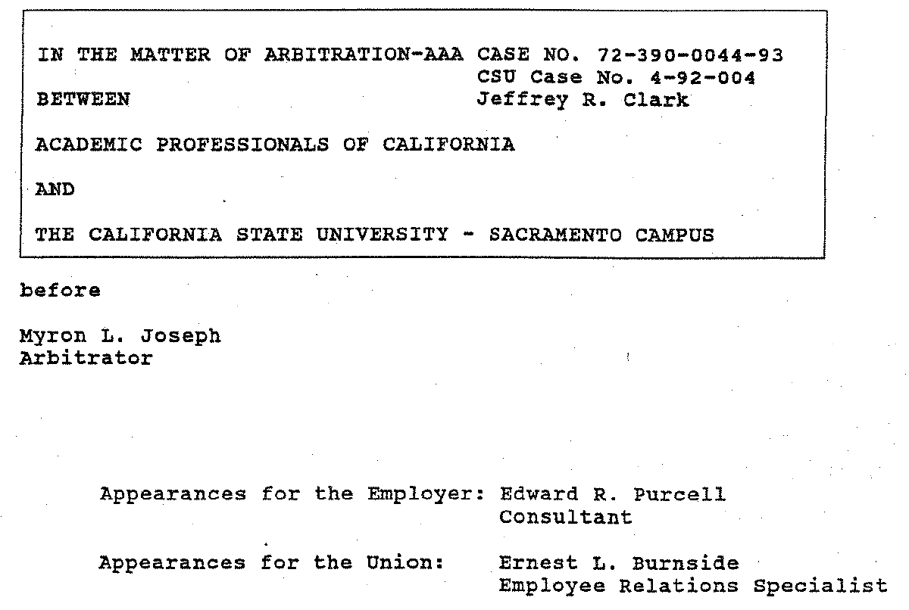
Case Study II: Sacramento (Clark)

Slide 39
Case Study II: Sacramento (Clark)

Slide 40
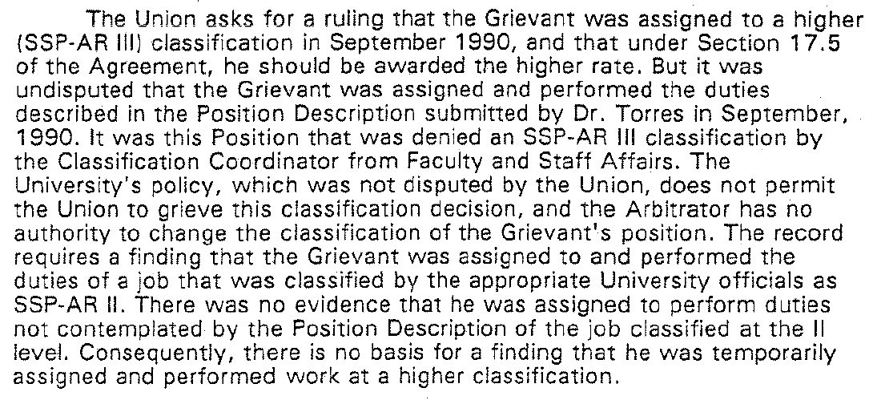
Case Study II: Sacramento (Clark)

Slide 41
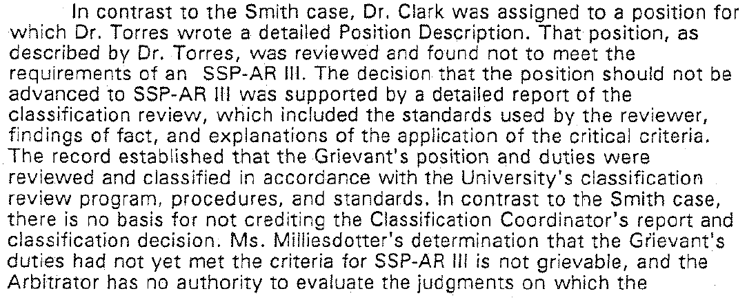
Case Study II: Sacramento (Clark)

Slide 42
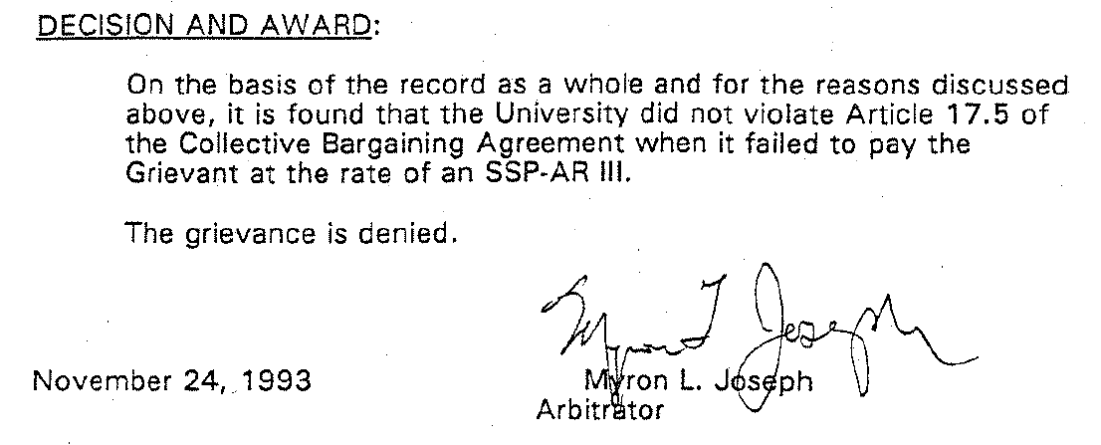
Case Study IV: Sacramento (Clark)

Slide 43
Closing Thought

