Slide 1

“Exempt” and “Non-Exempt” Employees:
What the Distinction Means for Unit 4 Members

Slide 2
Topics Covered
Summary of the Fair Labor Standards Act
Different Forms of Overtime “Compensation”
The Administrative Exemption
How the CSU Applies the Administrative Exemption to Unit 4 Employees
What the CBA Offers to Unit 4 Employees Above and Beyond the FLSA
Some Frequently Asked Questions

Slide 3
Summary of the FLSA
The Fair Labor Standards Act (FLSA) requires CSU to pay:
“minimum wage”
  currently $7.25 per hour
“overtime”
  one and one-half times the employee’s “regular rate” for each hour worked beyond forty hours in any “workweek.”

Slide 4
Overtime “Compensation”
Overtime Compensation
  at one and one-half times the employee’s “regular rate” for each hour worked beyond forty hours in any “workweek.”
Compensatory Time Off
  at a rate not less than one and one-half hours for each hour of employment for which overtime compensation is required

Slide 5
Overtime “Compensation” cont.
Compensatory time in lieu of overtime compensation is permissible only “pursuant to”
either “applicable provisions of a collective bargaining agreement”
or “an agreement or understanding arrived at between the employer and employee before the performance of the work”

Slide 6
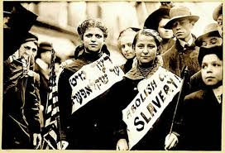
Summary of the FLSA continued

Slide 7
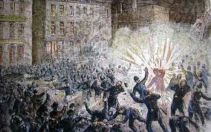
Summary of the FLSA continued

Slide 8
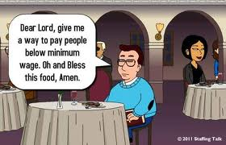
The Administrative Exemption

Slide 9
Admin. Exemption continued
29 USC § 213(a)
“The [minimum wage and overtime] provisions of this title shall not apply with respect to—
(1) any employee employed in a bona fide executive, administrative, or professional capacity . . . .”

Slide 10
Admin. Exemption continued
29 CFR § 541.200(a)
“The term ‘employee employed in a bona fide administrative capacity’ in [29 USC § 213(a)(1)] shall mean any employee:
(1) Compensated on a salary or fee basis at a rate of not less than $455 per week . . . , exclusive of board, lodging or other facilities;
(2) Whose primary duty is the performance of office or non-manual work directly related to the management or general business operations of the employer or the employer's customers; and
(3) Whose primary duty includes the exercise of discretion and independent judgment with respect to matters of significance.”

Slide 11
Exempt Unit 4 Employees
Class Code Classification Title
3081 Student Services Professional II - 10-month
3082 Student Services Professional II - 12-month
3083 Student Services Professional II - Academic Year
3084 Student Services Professional III - 12-month
3085 Student Services Professional III - Academic Year
3086 Student Services Professional IV - 12-month
3087 Student Services Professional IV - Academic Year
3088 Student Services Professional III - 10 month
3089 Student Services Professional IV - 10 month
5181 Extended Education Specialist I
5182 Extended Education Specialist II
2802 Educational Television Program Director, SDSU

Slide 12
Non-Exempt Unit 4 Employees
Class Code Classification Title
2627 Credential Analyst Trainee
2628 Credential Analyst I
2630 Credential Analyst II
2632 Evaluator I
2633 Evaluator II
2634 Evaluator Trainee
2635 Student Personnel Technician, Financial Aid
2895 Lead Library Assistant II
2896 Lead Library Assistant III
2891 Lead Library Assistant IV
3078 Student Services Professional I - 10-month
3079 Student Services Professional I - 12-month
3080 Student Services Professional I - Academic Year
9164 Placement Interviewer

Slide 13
SSPs I
Technical Letter HR 95-18

Slide 14
SSPs I continued

Slide 15
SSPs I continued

Slide 16
Exempt Unit 4 Employees
Article 28.27
Exempt employees
are entitled to a workweek of “an average of forty (40) hours per week during any six (6) consecutive pay periods”
“shall not be assigned an unreasonable or excessive workload.”

Slide 17
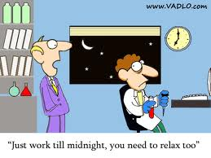
Exempt Unit 4 Employees cont.

Slide 18
Exempt & Non-Exempt Unit 4 Employees
Exempt and non-exempt Unit 4 employees are entitled to unpaid meal periods.
28.9 An employee shall be entitled to a meal period not to exceed sixty (60) minutes. The time of such a meal period shall be designated by the appropriate administrator. The appropriate administrator may adjust meal periods to account for variations in work schedules. Such meal periods shall not count toward hours worked, except as provided for in provision 28.10.

Slide 19
Non-Exempt Unit 4 Employees
Non-exempt Unit 4 employees are entitled to overtime.
28.17 Overtime shall be compensated at one and a half (1 1/2) times the employee's regular hourly rate.
28.19 All overtime hours worked shall be compensated by cash or compensatory time off (CTO) as determined by the appropriate administrator.

Slide 20
Non-Exempt Unit 4 Employees cont.
Non-exempt Unit 4 employees are entitled to rest periods.
28.14 An employee in a classification listed in Appendix D shall be allowed rest periods each workday of fifteen (15) minutes for each four (4) hours worked. Rest period schedules shall be determined by the appropriate administrator in accordance with the requirements of the department. Rest periods shall be counted toward hours worked. Rest period time not taken shall not be cumulative.

Slide 21
Non-Exempt Unit 4 Employees cont.
Non-exempt Unit 4 employees are entitled to paid meal periods if they are required to remain “on the job”:
28.10 An employee in a classification listed in Appendix D who is required to remain on the job at his/her work station for a full workday shall be permitted to take a meal period, not to exceed thirty (30) minutes, during work time.

Slide 22

Residence Life Employees
Residence life employees are entitled to compensation for “on-call time” and “call backs.”

Slide 23
Residence Life Employees cont.
“Restricted” On-Call Time
If “CSU imposes mandatory restrictions on an employee’s alcohol use or his or her geographical location while on-call,”
then “the entire period of continuous on-call time” counts as “hours worked.”

Slide 24
Residence Life Employees cont.
“Unrestricted” On-Call Time
If CSU requires only that the employee be “available to report for work fit for duty and in a timely manner,”
then only the first two hours of continuous on-call time count as “hours worked.”

Slide 25
Residence Life Employees cont.
Call-Back
If an employee is called back to actually work while on on-call time,
then the actual time worked beyond the two hours on-call discussed in the previous slide also counts as “hours worked.”

Slide 26
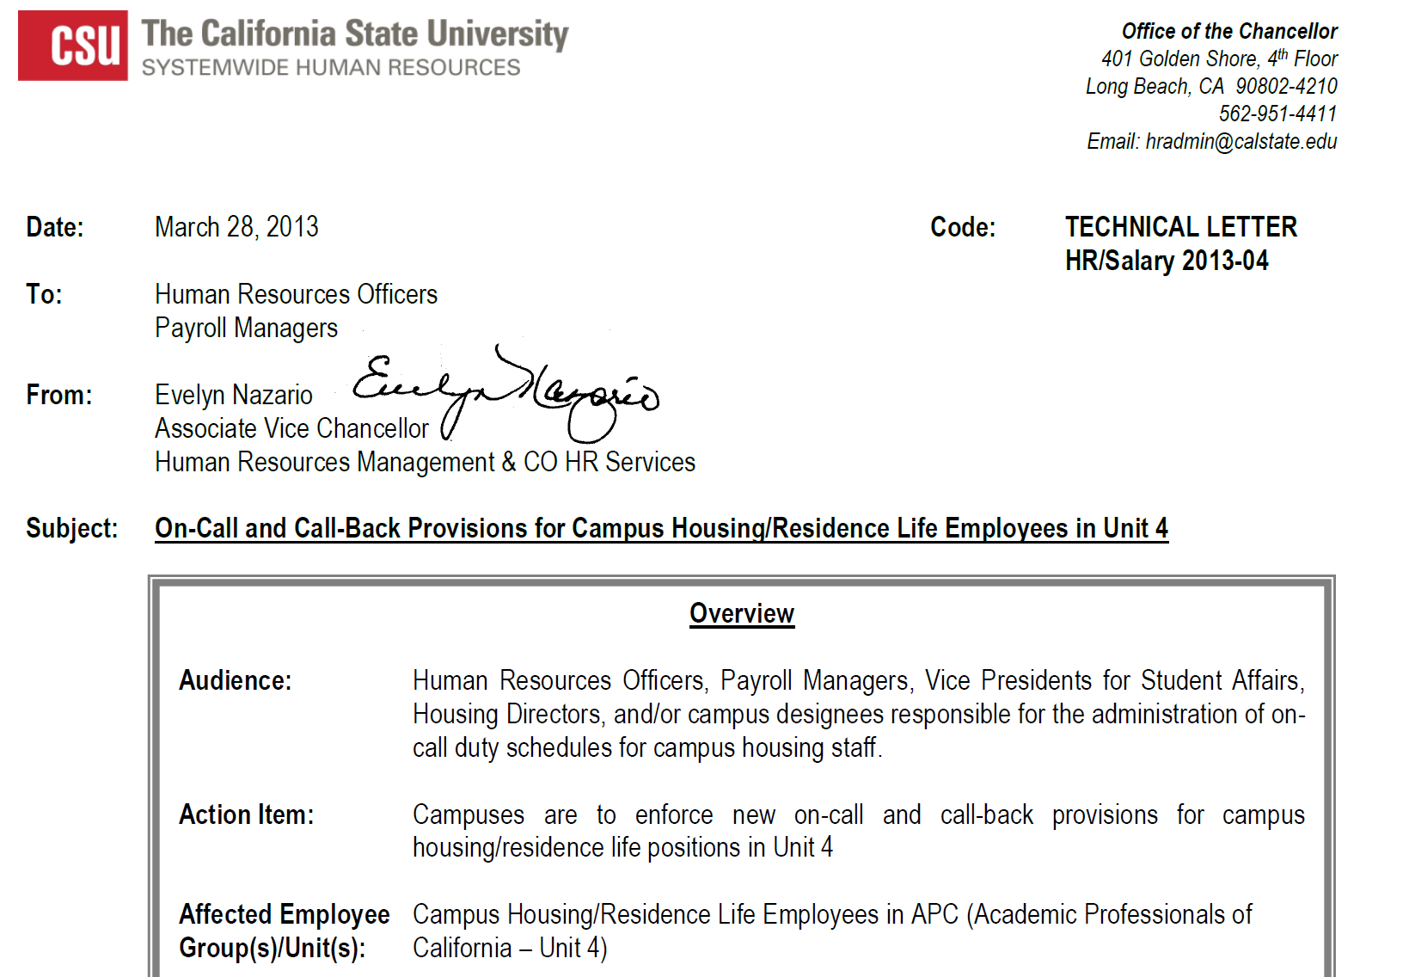
Residence Life Employees cont.

Slide 27
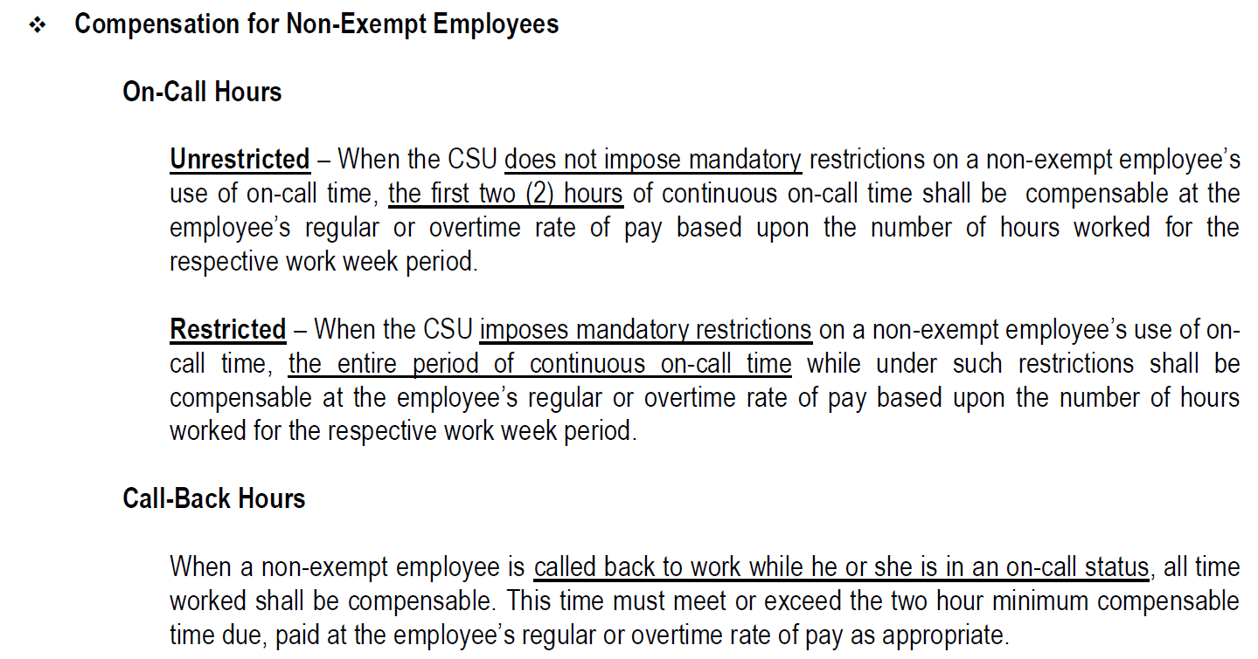
Residence Life Employees cont.

Slide 28
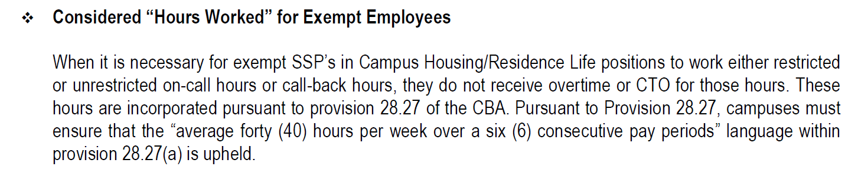
Residence Life Employees cont.

Slide 29

Frequently Asked Question I
Question:
“I am an exempt employee. Does that mean I can come and go as I please and work as much or little as I see fit?”

Slide 30
FAQ I continued
Answer:
No. Article 28.8 of the APC-CSU collective bargaining agreement states: “Daily and weekly work schedules shall be established by the appropriate administrator.” If you deviate from your established work schedule without prior approval from the appropriate administrator or a valid excuse, you may be subject to discipline. In addition, Article 28.27(D) states that ‘[i]f a manager feels an employee is not working an appropriate number of hours, the employee should be counseled.’ The article explicitly mentions only ‘non-disciplinary, corrective action,” i.e., “oral warning and written reprimands.” However, disciplinary action—i.e., “dismissal, demotion, or suspension without pay” are also a possibility if you work ethic is found lacking.

Slide 31
Frequently Asked Question II
Question:
“I am an exempt employee. My supervisor keeps giving me an unreasonable amount of work and telling me to have it done by the end of the week. It routinely takes me fifty hours a week to do all the work he has given me that week. Can I stop working once I have worked forty hours in a week and refuse to do any additional work that week?”

Slide 32
FAQ II continued
Answer:
No. Your supervisor may be violating Article 28.27, which provides that, for exempt employees, “the workweek shall be an average of forty (40) hours per week during any six (6) consecutive pay periods” and that such “[e]mployees shall not be assigned an unreasonable or excessive workload.” However, under the rule “work now, grieve later,” your only option is to follow instructions and file a grievance. If you refuse to do the additional work, you may be subject to discipline. You should keep written time records for your grievance.

Slide 33
Frequently Asked Question III
Question:
“I am an exempt employee. Yesterday, I became sick in the afternoon and had to leave two hours early. My supervisor told me this morning that I have to use two hours of sick leave for this. Can she do that?”

Slide 34
FAQ III continued
Answer:
No. Article 28.27 provides that exempt “[e]mployees who have absences of less than a full day shall receive a full day's salary and shall neither have their salary docked nor be required to use sick leave or vacation for such absences of less than a full day.”

Slide 35
Frequently Asked Question IV
Question:
“I am a non-exempt employee. My supervisor tells me I have to take compensation for overtime as compensatory time off instead of cash. Can he do that?”

Slide 36
FAQ IV continued
Answer:
Depends.
While the CBA is in effect, your supervisor can make you take compensation for overtime as compensatory time off. [Article 28.19]
Once the CBA has expired, your supervisor must pay you cash for overtime.

Slide 37
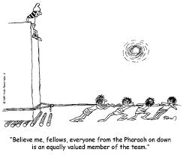
Closing Thought

